Slide 1




Hakseng Group
Team 2
Khasan 201939094
Bekhzod 201839016
Abduvakhob 201939062

Slide 2

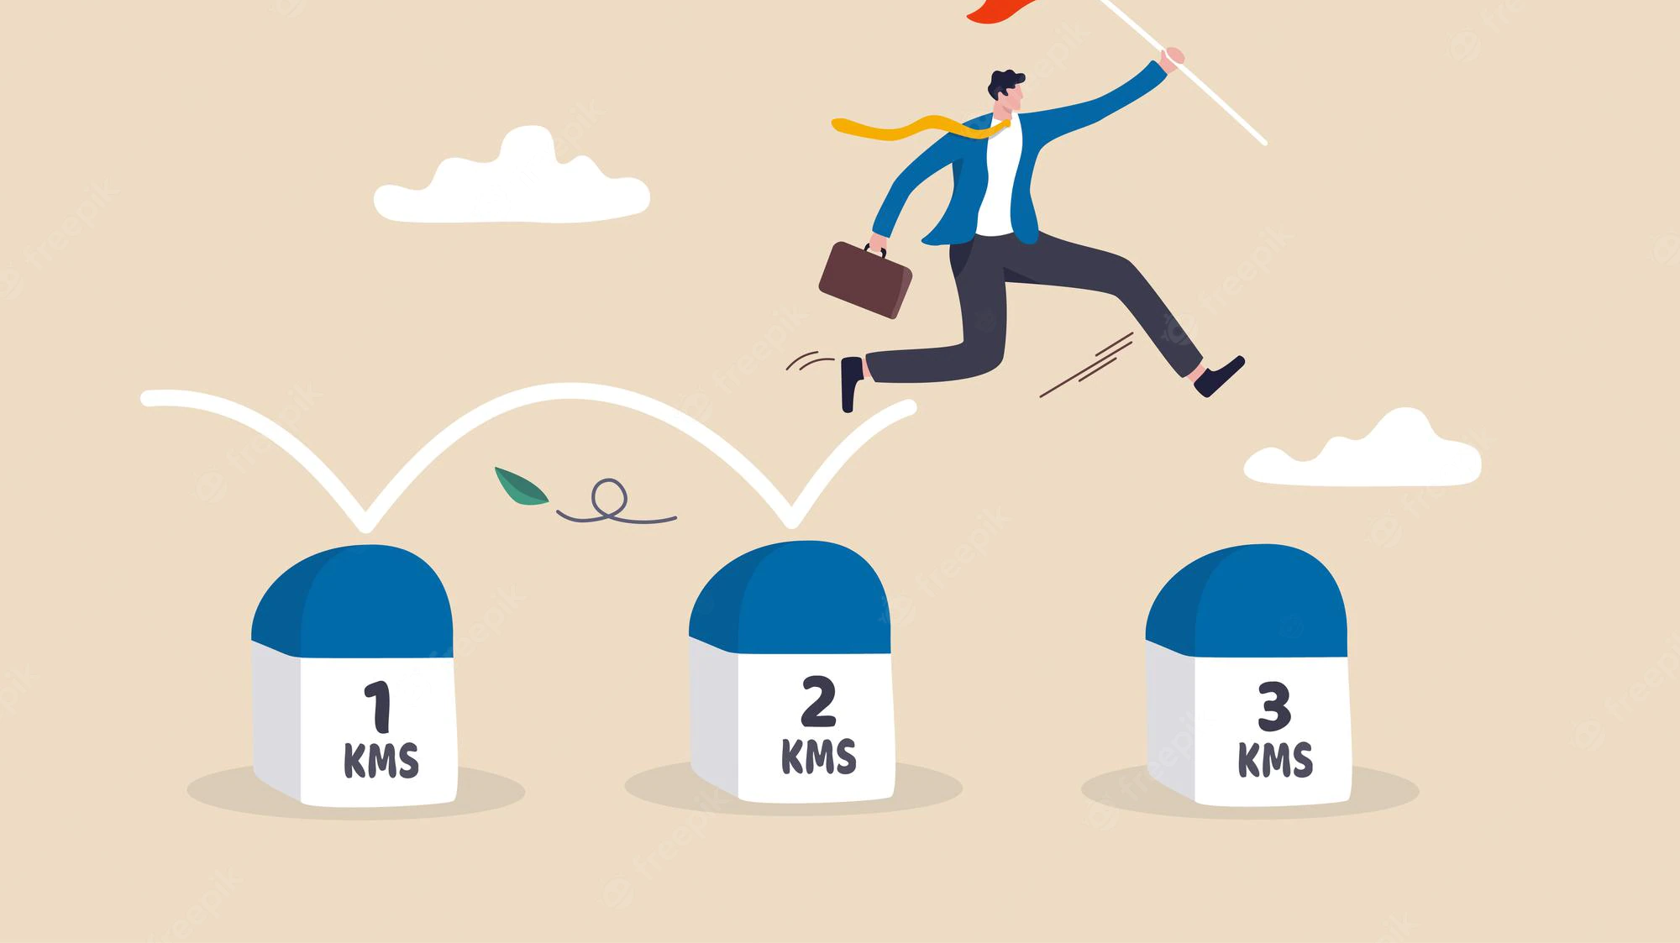




Overall Milestone
4-10th Week Development of Project
11-12th Week Final Presentation
1-3rd Week
Discussion of Project

Slide 3

Milestone
Bekhzod 201839016 – is responsible for graphic design, User Interface and User Experience UI/UX. Bekhzod used Figma for designing the project. Figma is a collaborative web application for interface design along with the most obvious advantage of Figma is that you don't need to know how to code. You simply drag and drop objects onto the canvas to build your prototype.​

Slide 4
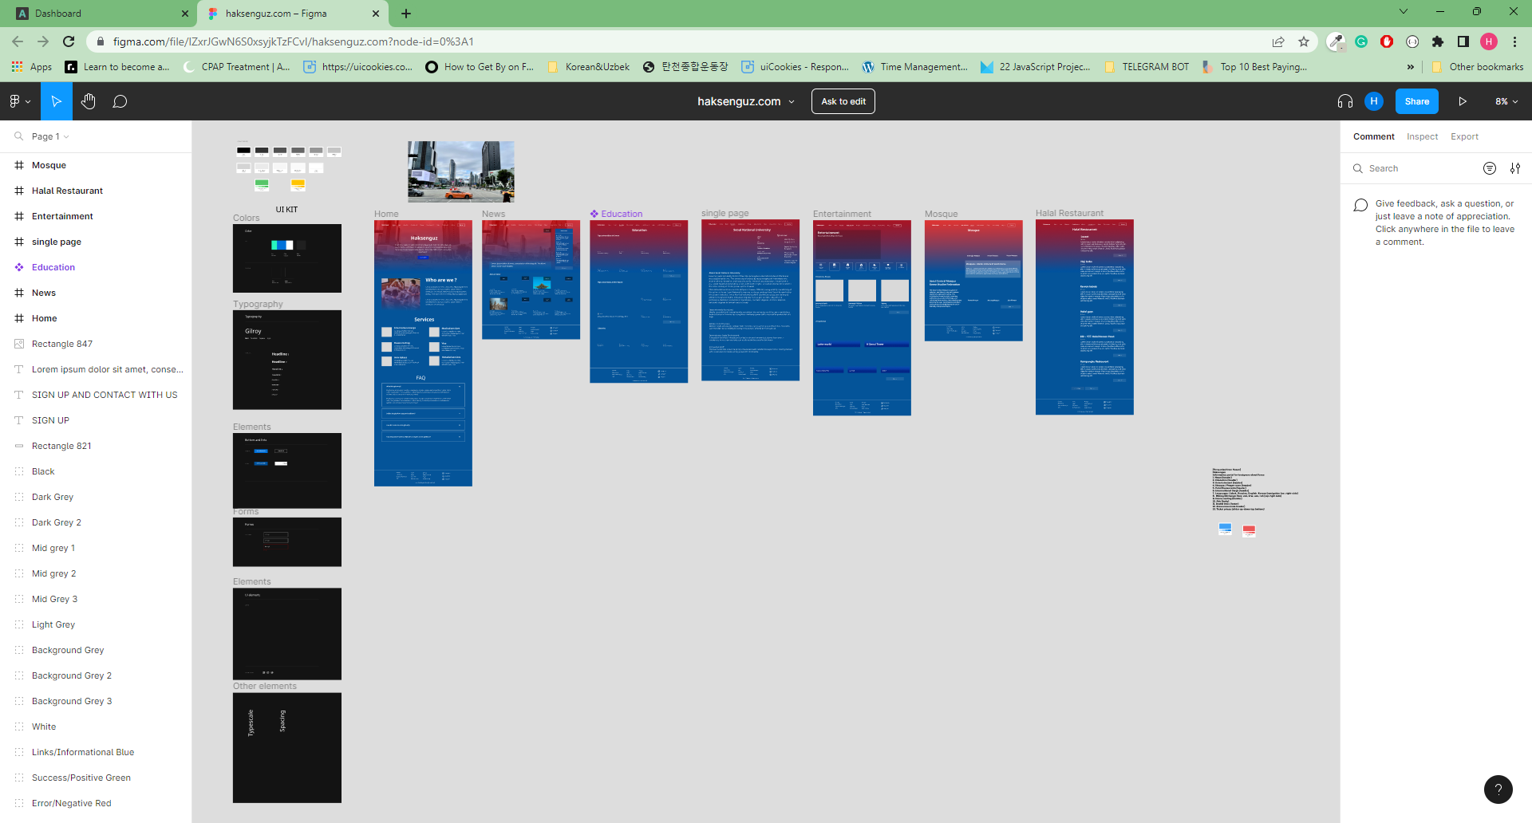
Figma
handles file organization by displaying projects and their files in a dedicated view.

Slide 5
Milestone
Completed by Bekhzod:
1. Designed Main Page and added Services section.
2. Worked on navigation bar and added extra sections such as “Actual News” and “Latest news”.
3. Designed Education page “Top universities Korea and the around the world”, “Libraries”

Slide 6
Milestone
4. Designed Single page for “Education& Latest news section
5. Designed Entertainment section, added “Historical Places” navigation bar description and add “Attraction” section.
6. Designed Mosque/Masjid’s sections.
7. Halal Restaurant section.
8. Post Service section.
9.House Renting.

Slide 7
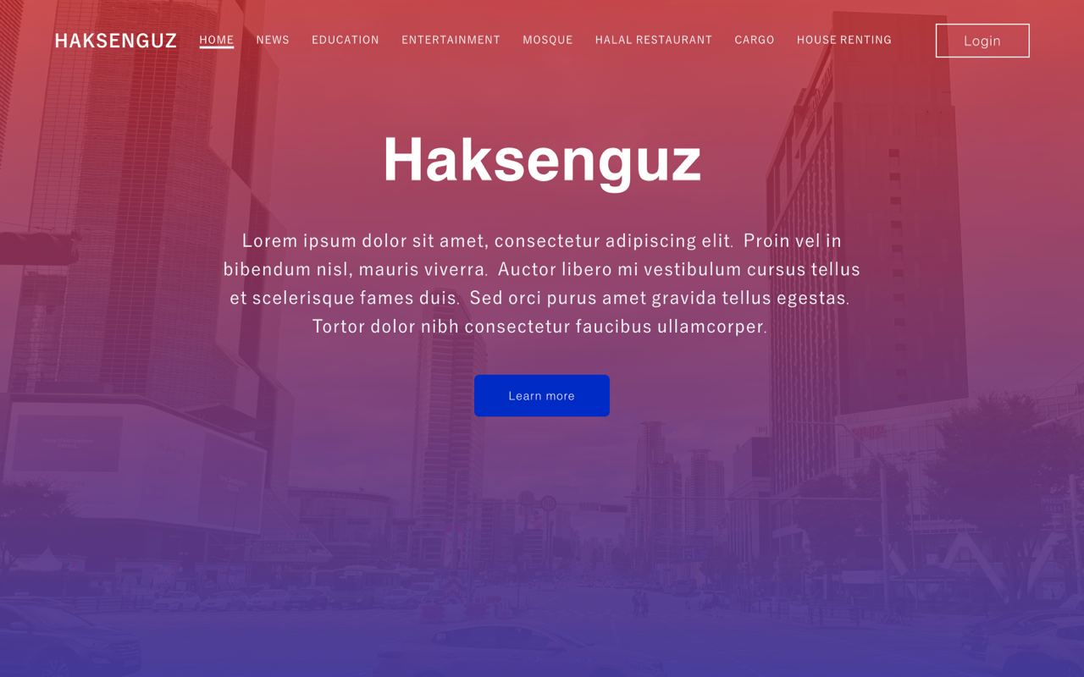

Slide 8

Demo
Let's turn to Demo part

Slide 9

Video Part
lxclclclcnlsclsnclsnclsnclscnlscnlsnclsncsl

Slide 10

Milestone
Abduvakhob 201939062 – responsible for developing new user-facing features, determining the structure and design of web pages, building reusable codes, optimizing page loading times, and using a variety of markup languages to create the web pages. and making front-end pages of our project. He made pages using HTML, CSS, JavaScript.

Slide 11
Milestone
Completed by Abduvkhob:
1. Add Main page
2. Make Page :
News
Single page of News
Education
Entertainment
Mosque
Halal Restaurant
Cargo
House Renting

Slide 12

Milestone
Khasan 201939094 (team leader) – is responsible for planning, dividing roles to each members of the team accordingly, monitoring weekly milestone performance, develop backend of the project. As a backend developer, Khasan is responsible for making database, setting up project by Laravel framework, retrieving data from database and rendering it on frontend page, and working with third party APIs.

Slide 13
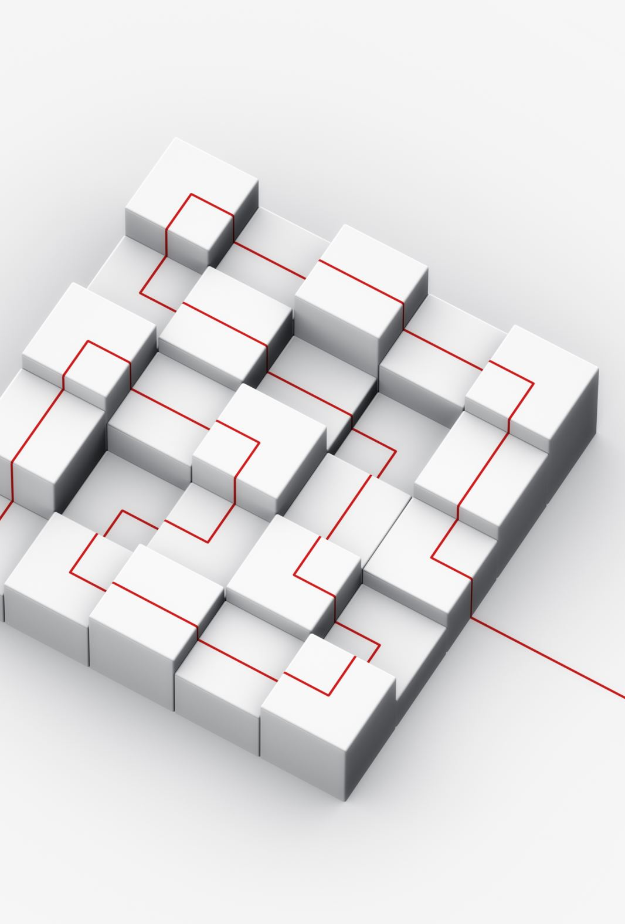
Milestone
Completed by Khasan:
Created ERD diagram
Created Database
Set up Laravel 9 project
Made APIs for retrieving data from database
Created database models
Created controllers for models
Created migration tables
Admin Dashboard

Slide 14
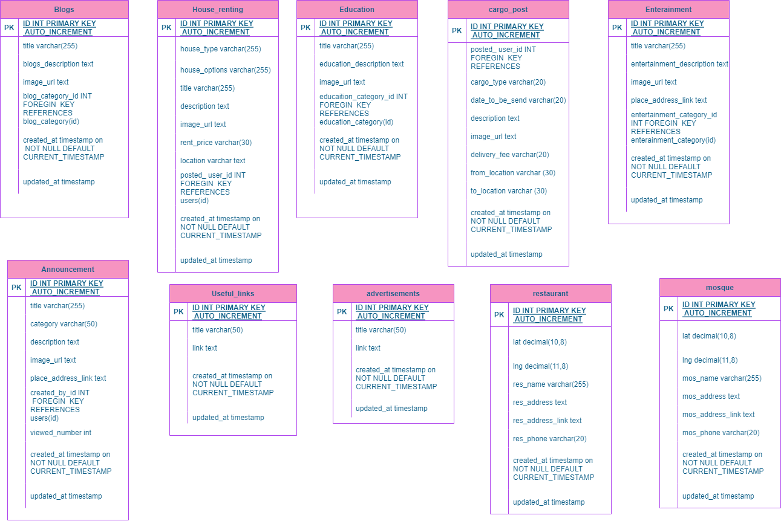
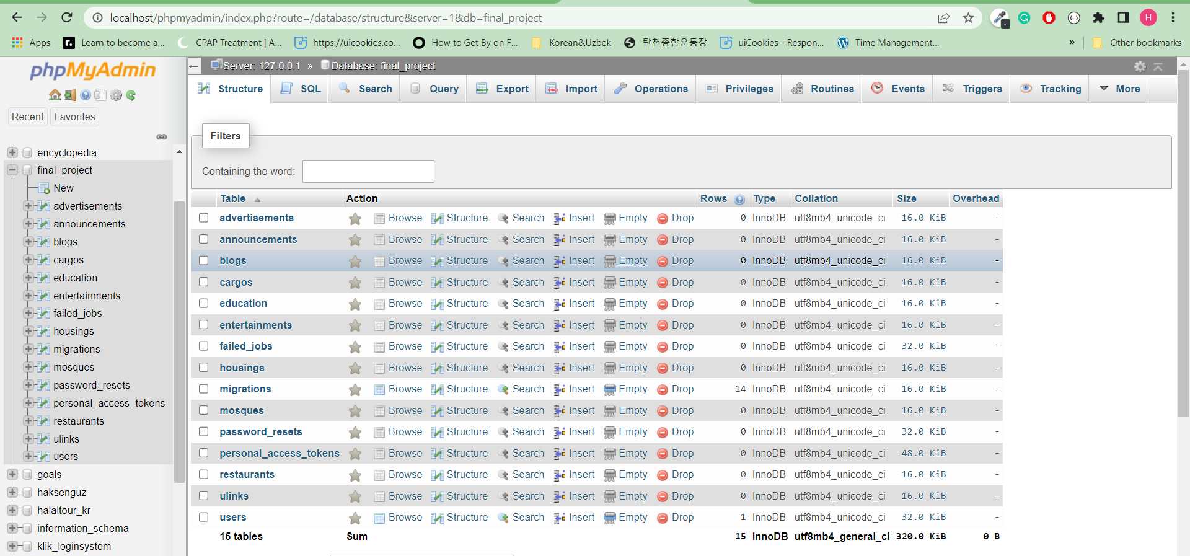
Database Erd diagram

Slide 15
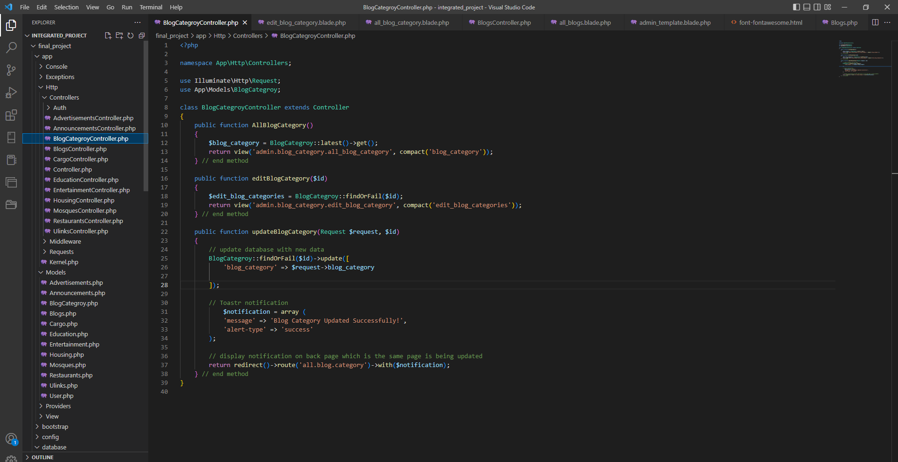
Php-Backend development

Slide 16
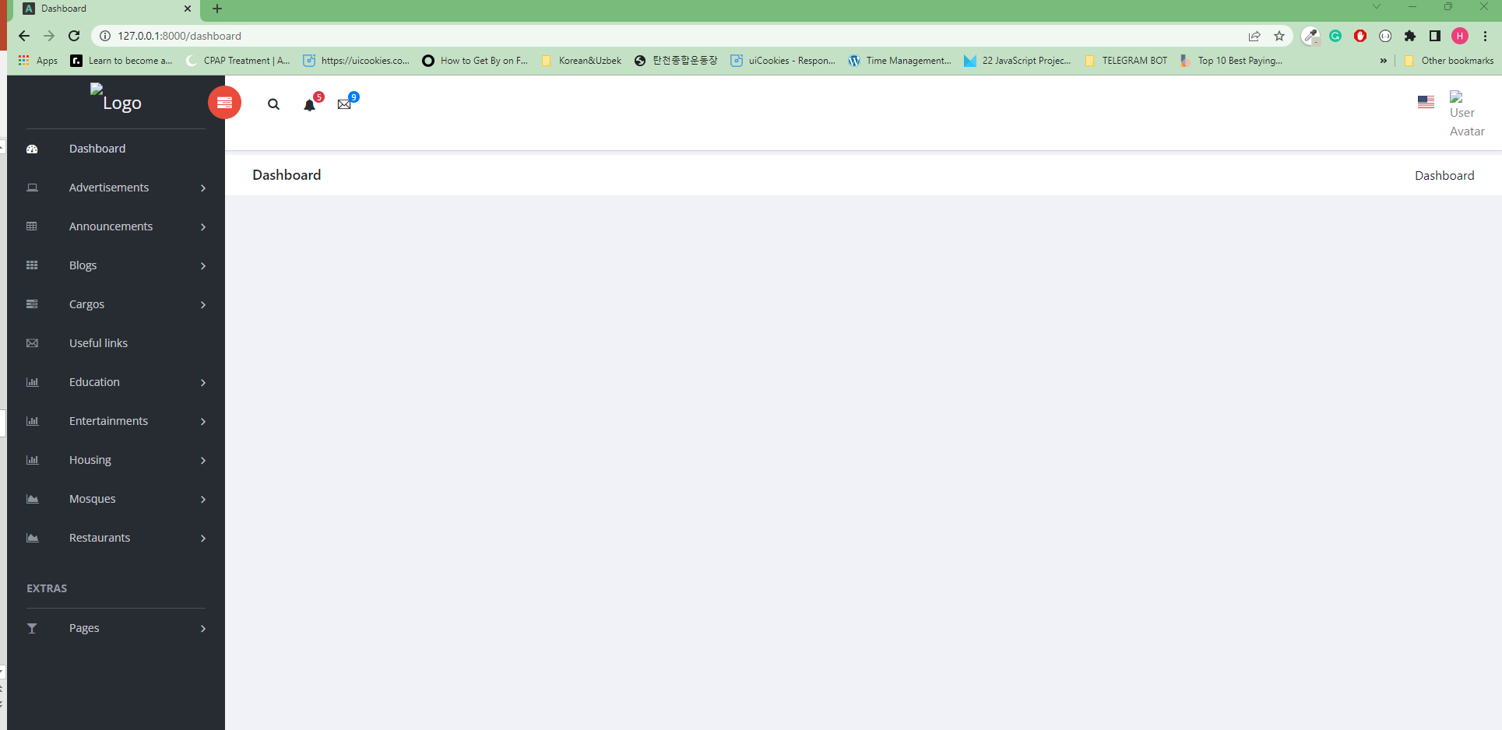

Slide 17
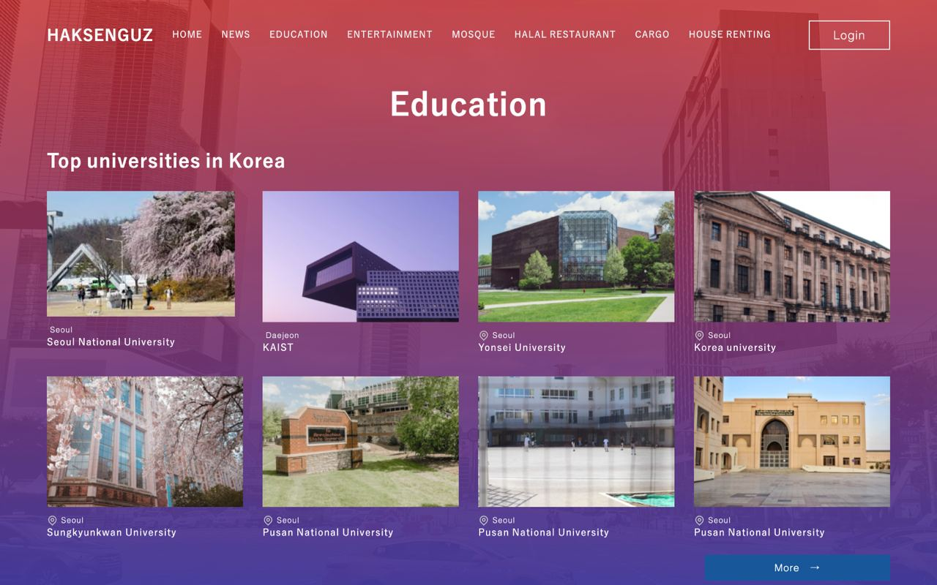

Slide 18
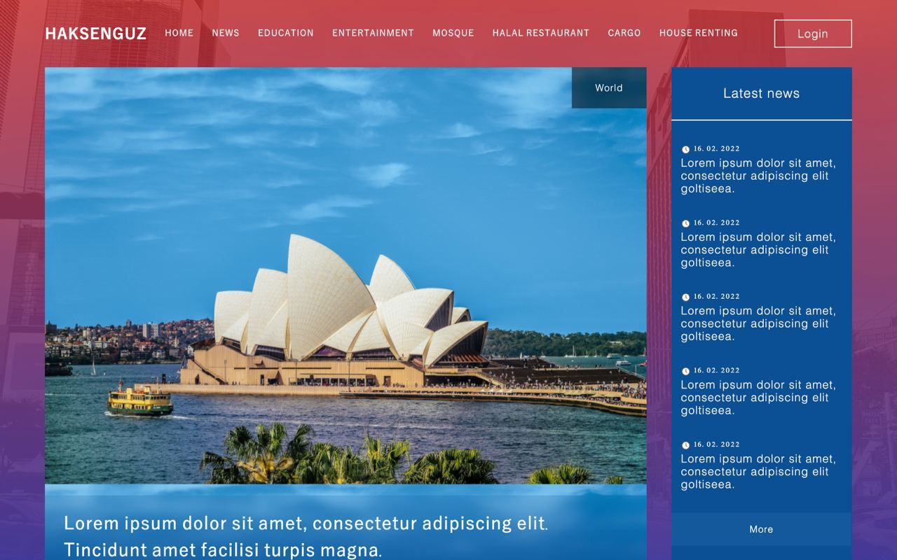

Slide 19
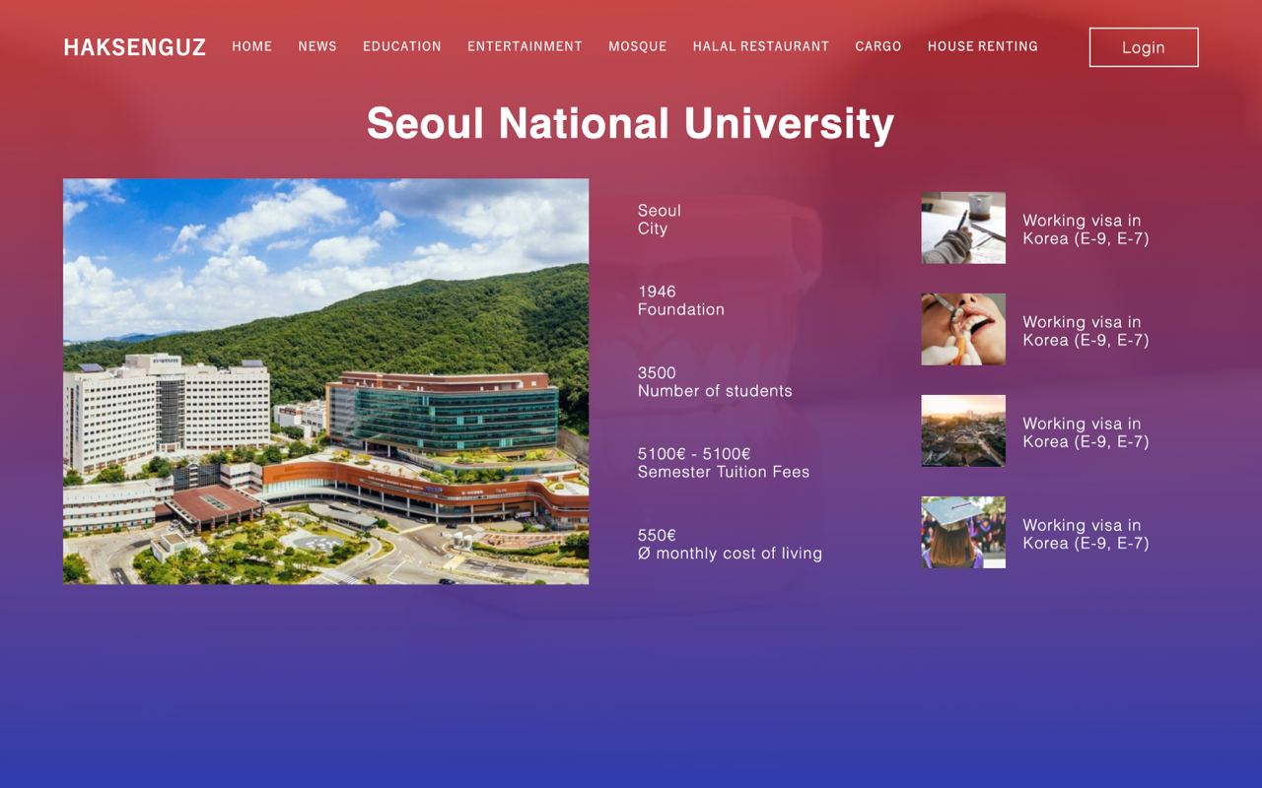

Slide 20
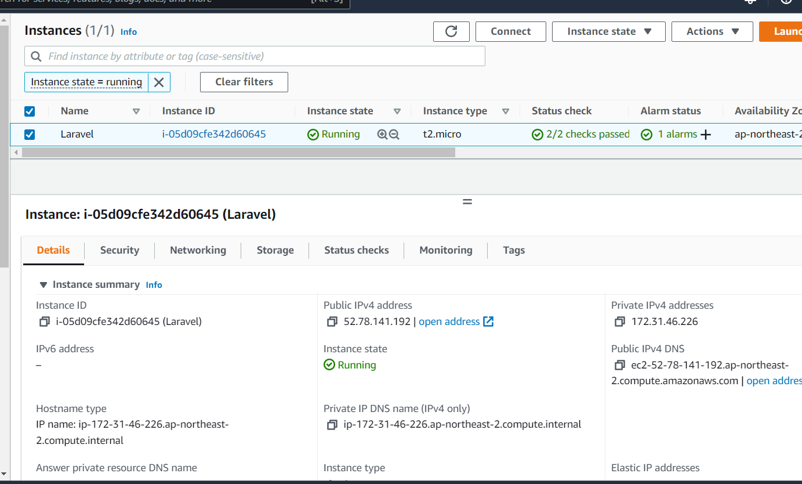

Aws ec2 instance: https://ap-northeast-2.console.aws.amazon.com/ec2/home?region=ap-northeast-2#Instances:instanceState=running
https://ap-northeast-2.console.aws.amazon.com/ec2/home?region=ap-northeast-2#Instances:instanceState=running

Slide 21
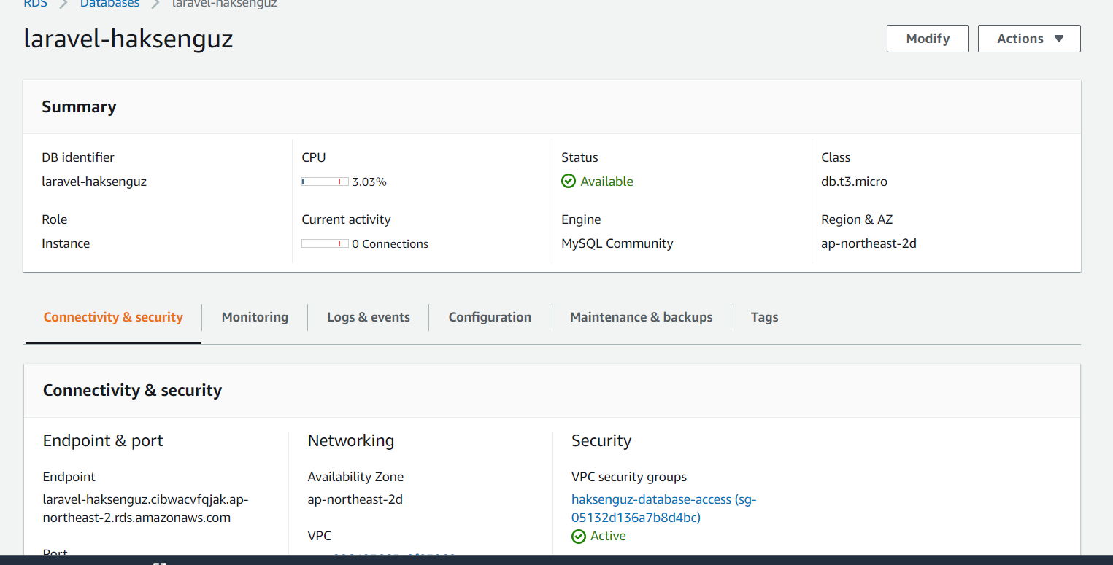

Database aws rds: https://ap-northeast-2.console.aws.amazon.com/rds/home?region=ap-northeast-2#database:id=laravel-haksenguz;is-cluster=false

Slide 22
Summary
Project Plan
Database creation
Project Setup
Backend APIs
Graphical User Interface
Frontend Pages

Slide 23

Thank you for your Attention

